Slide 1
LB840:
Bellevue’s Economic Development Plan

Slide 2
What is LB840?
In 1991, the Nebraska Unicameral implemented this amendment with the passage of Legislative Bill 840, the Local Option Municipal Economic Development Act.
LB840 allows cities and villages the power to use local sources of revenue for economic or industrial projects and programs.

Slide 3
Bellevue’s Strategy
The principal strategy is directed at maintaining a good quality of life, building a strong workforce, developing community resources, attracting new capital investment, broadening the community's tax base and ensuring economic stability and viability for the City of Bellevue.
An economic development program can establish the city as a nurturing environment for small and large businesses alike.
This atmosphere will encourage people with skills and ideas to move or return to Bellevue to do business as well as retain current residents.

Slide 4
Purpose & Intent
The City of Bellevue intends to implement the Economic Development Program within the southeast corner of the City's planning and zoning jurisdiction.
The City of Bellevue will promote new development in the ±5000 acre area identified as the Highway 34 Corridor District which is in Sarpy County from the Missouri River west to Highway 75 and from the Platte River north to approximately Cunningham & Fairview Roads.

Slide 5
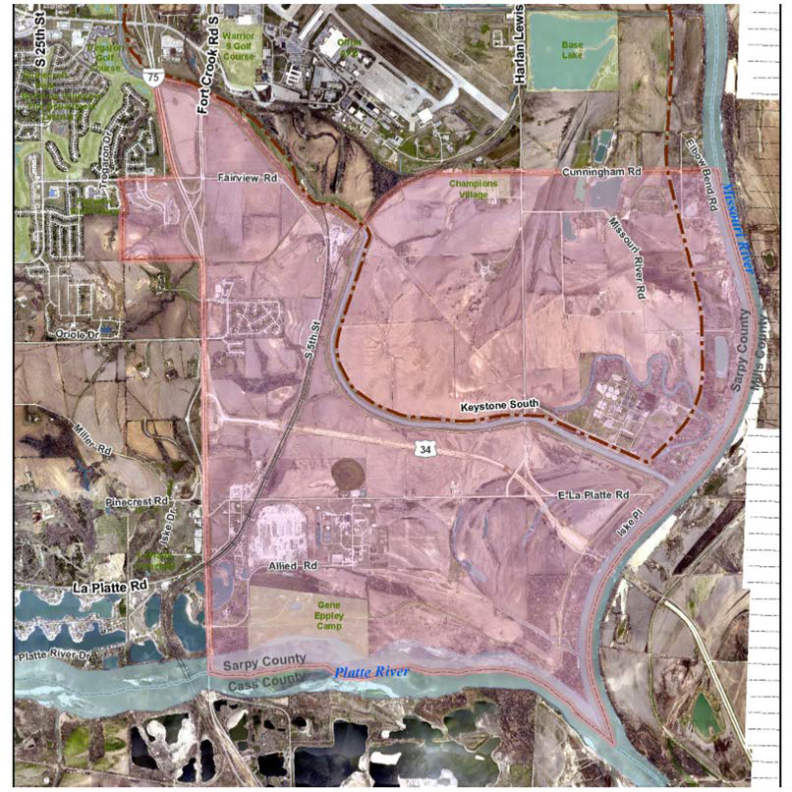
Highway 34 Corridor District

Slide 6
Goals for the HWY 34 Corridor District
Create new jobs
Generate employment
Attract a variety of new businesses
Attract new capital investment
Broaden the tax base
Expand the labor market
Compliment and further the goals of the City’s Comprehensive Plan and the Highway 34 Corridor Overlay

Slide 7
Eligible Activities
Eligible economic activities of the Economic Development Program within the Highway 34 Corridor District are:
  Purchase Land
  Execute Options
  Construction or Infrastructure Financing
  Loan Fund

Slide 8
Purchase of Land
City of Bellevue may purchase real property or execute options for real property located within the Highway 34 Corridor District.
After a review, the Program Administrator will make a recommendation to the Mayor and City Council regarding land purchase or option.
The City shall comply with all statutory requirements when purchasing real property.
Proceeds from the sale of real property shall be returned to the City of Bellevue's Economic Development Fund for future use.

Slide 9
Infrastructure Improvements
The City of Bellevue may make expenditures or grants for public works improvements, site development and infrastructure such as water, sewer, electrical, gas, transportation and Missouri River.
Any expenditures for access to transportation shall specifically include installation of railroad tracks, railroad crossings, rail switch stations and docks or piers for loading and unloading barges and other river transportation vessels.

Slide 10
Loan Fund
The loan fund shall be organized and operated as determined by the City of Bellevue based on programs offered by the Small Business Administration (SBA) or the State of Nebraska.
The City of Bellevue can in any case impose additional or greater requirements, standards, criteria or conditions as determined appropriate.

Slide 11
Minimum Requirements by SBA or State of Nebraska
Types of financial assistance available, the maximum proportion of financial assistance that will be provided to any single qualifying business and the criteria used to determine the appropriate level of assistance;
The criteria and procedures that will be used to determine the necessity and appropriateness of permitting a qualifying business to participate in the loan fund;
The criteria for determining the time within which a qualifying business must meet the goals set for it under its participation agreement; and
Standards for loan delinquency, declaration of default, and actions to be taken upon default (consistent with Neb. Rev. Stat. section 18-2720).

Slide 12
Loan Fund (cont.)
The loan fund will be administered in accordance with applicable law, including Neb. Rev. Stat. section 18-2720.
The loan fund will be audited annually in conjunction with the audit of the Economic Development Program pursuant to Neb. Rev. Stat. section 18-2721.
Nebraska Statutes 18-2705 through 18-2722 provide the governing language for the Economic Development Program.

Slide 13
Source of Local Option Funds
Existing local option City Sales and Use Tax, Lodging Tax, Occupancy Tax and Real Estate Tax.
City of Bellevue may not appropriate funds to fund the Economic Development Program if the City Council (by resolution) or the voters (by ballot) do not approve the appropriation.
Additional funds from other non-City sources will be sought beyond those derived from local sources of revenue, such as Tourism Grants.

Slide 14
Length of Time the Program will Exist
May 1, 2015 until April 30, 2040.
Miscellaneous revenues and funds, including repayment of loans, return on investments, fees, and proceeds from properties, may continue to be used for activities within the program during the life of the program.

Slide 15
Preliminary Budget
City of Bellevue shall establish an Economic Development Fund.
Shall contribute an amount not to exceed
$375,000 for any one-half year; or
Shall contribute an amount not to exceed
$750,000 per year beginning May 1, 2015 and ending April 30, 2035.
The minimum expenditure in any one year shall not exceed the amount contributed for that year plus any surplus funds from previous years plus any non-City source of funds available.

Slide 16
Bond Authority
Following a public hearing, the Bellevue City Council may authorize the issuance of bonds to carry out this Economic Development Program.
Future contributions of Local Option City Sales and Use Tax, Lodging Tax, Occupancy Tax and Real Estate Tax to the Economic Development Fund shall be used to pay off these bonds.

Slide 17
Administrative Process
Citizen Advisory Review Committee (the Committee) established by Mayor and Council.
Five voting members; 3 members must have expertise in business, finance or accounting.
Ex-officio members from the City of Bellevue include the Program Administrator, the City Administrator and Designated City Official

Slide 18
Meetings
The Committee will meet to review applications on an as needed basis.
The Committee will also meet on a quarterly basis to review the progress of the Economic Development Program.
The Committee will report its findings and suggestions to the Bellevue City Council on no less than a semi-annual basis.
The Bellevue City Council may assign additional responsibilities to the Committee as necessary.

Slide 19
Application Process
Program applicants must provide the following information:
  A detailed description of the proposed project, including an address or legal description for the proposed project located within the Highway 34 Corridor District.
  A business plan that includes employment and financial projections, current financial statements, financing requirements for the project and total projected costs.
  A completed City of Bellevue Local Option Municipal Economic Development Program application.

Slide 20
Application Process (cont.)
The Committee will review applications in the order they are received.
Approval/disapproval of an application will be based on project feasibility and the potential future economic benefit.
After a financial verification process, the Committee may, or may not, recommend approval of an application.
After the Committee’s recommendation is determined, the application will be presented to the Bellevue City Council for consideration.

Slide 21
Upon Approval
After Bellevue City Council approval, and provided that proper execution of the agreements are made, the Bellevue City Council will provide a suitable timeframe to disburse funds meeting the requirements of the applicant.

Slide 22
Key Contacts
Jim Ristow, City Administrator & LB840 Program Administrator
Email: Jim.Ristow@Bellevue.net Phone: (402)293-3022
Rich Severson, Finance Director Email: Rich.Severson@Bellevue.net Phone: (402)293-3088

